Slide 1

CS415: Databases

Slide 2
Lesson 2
The Relational Model and SQL

Slide 3
Wholeness
This lecture focuses on studying the underpinning concepts behind Relational Databases, which is the Relational model.
We will also learn the language for working with data in a Relational database - SQL. The Structured Query language (SQL) is a standard across any RDBMS. This is akin to how the Unified field is the basis for all of life.

Slide 4
Lesson 2 Objectives
The origins of the Relational model.
The terminology of the Relational model.
How tables are used to represent data.
The connection between mathematical relations and relations in the relational model.
Properties of database relations.
How to identify primary and foreign keys.
The meaning of entity integrity and referential integrity.
The purpose and advantages of views in relational systems.
…

Slide 5
2.1 Introduction to the Relational model
The Relational Database Management System (RDBMS) has been the dominant database technology in the enterprise for much of the last 50 years.
It represents the second generation of DBMSs and is based on the relational data model proposed by E. F. Codd (1970).
In the relational model, all data is logically structured within relations (tables). Each relation has a name and is made up of named attributes (columns) of data. Each tuple (row) contains one value per attribute. A great strength of the relational model is this simple logical structure.

Slide 6
2.2 Brief history
The Relational model was first proposed by E. F. Codd in his seminal paper “A relational model of data for large shared data banks” in 1970.
Based on Codd’s paper, IBM's San Jose Research lab implemented a prototype relational DBMS named, System R, which included the development of a structured query language, SQL – now the ISO/de facto standard language for RDBMSs.

Slide 7
2.2 Brief history
During the late 1970’s and the 1980’s various commercial RDBMSs were produced – beginning with IBM’s DB2 and Oracle from Oracle Corporation.
Today, there are several hundred RDBMSs for both mainframe computers and PC environments.

Slide 8
2.3 Terminology
The relational model is based on the mathematical concept of a relation. The concept is derived from the mathematical topic of set theory and predicate logic.
Relation: A relation is a table of columns and rows.
Attribute: An attribute is a named column of a relation.
Domain: A domain represents the set of allowable values for one or more attributes. Every attribute in a relation is defined on a domain.
Tuple: A tuple is a row of a relation. The elements of a relation are the rows or tuples in the table.

Slide 9
2.3 Terminology
Degree: The degree of a relation is the number of attributes it contains. A relation with only one attribute would have degree one and be called a unary relation or one-tuple. A relation with two attributes is called binary, one with three attributes is called ternary, and after that the term n-ary is usually used.
Cardinality: The cardinality of a relation is the number of tuples it contains. This changes as tuples are added or deleted.

Slide 10
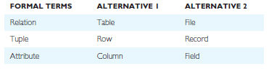
2.3 Terminology
Relational Database: a collection of normalized relations with distinct relation names. A relational database consists of relations that are appropriately structured. We refer to this appropriateness as normalization. We will study Normalization in further detail in Lessons 3 and 4.
Alternative terminology for relational model terms.

Slide 11
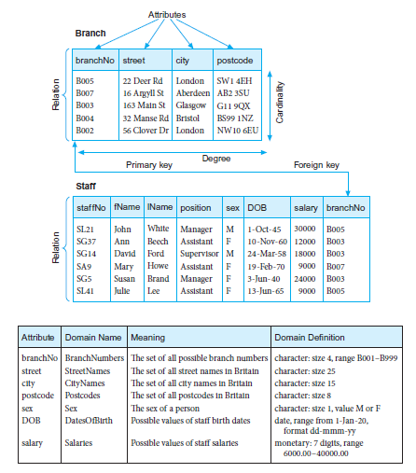
Example
Figure 2.1

Slide 12
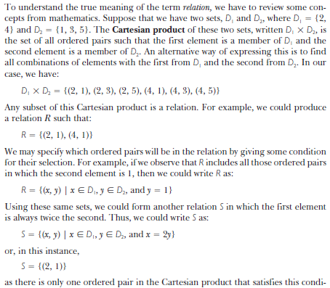
2.4 Mathematical relations

Slide 13
2.5 Relational keys
Primary key: A chosen attribute, or set of attributes, that uniquely identifies a tuple within a relation.
Foreign key: An attribute, or set of attributes, within one relation that matches the primary key of some other relation.

Slide 14
2.5 Relational keys
When an attribute appears in more than one relation, its appearance usually represents a relationship between tuples of the two relations. For example, in Figure 2.1 above, the inclusion of branchNo in both the Branch and Staff relations is quite deliberate and links each branch to the details of staff working at that branch. In the Branch relation, branchNo is the primary key. However, in the Staff relation, the branchNo attribute exists to match staff to the branch office they work in. In the Staff relation, branchNo is a foreign key.

Slide 15
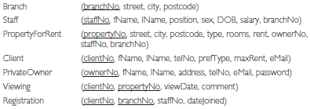
2.6 Representing relational database schema
The common convention for representing a relation schema is to give the name of the relation followed by the attribute names in parentheses. Normally, the primary key is underlined. For example, the relational schema for part of the DreamHome case study is:

Slide 16
2.6 Representing relational database schema
The conceptual model, or conceptual schema, is the set of all such schemas for the database.

Slide 17
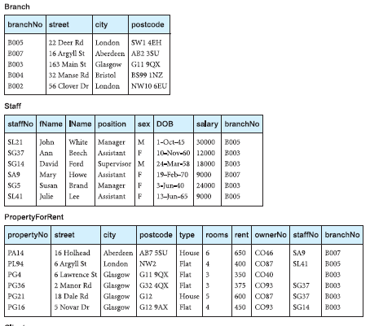
2.6 Representing relational database schema
Instance of the database schema for the DreamHome rental database:

Slide 18
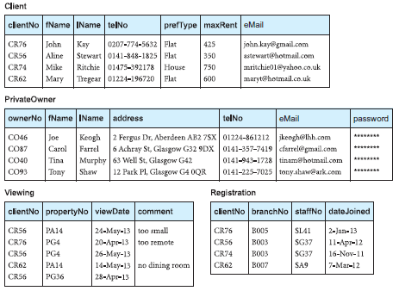
2.6 Representing relational database schema
Instance of the database schema for the DreamHome rental database cont’d:
Fig. 2.2

Slide 19
2.7 Integrity Constraints
In addition to the structural part, a data model such as the relational data model, has two other parts: a manipulative part, defining the types of operation that are allowed on the data, and a set of integrity constraints, which ensure that the data is accurate.
Because every attribute has an associated domain, there are constraints (called domain constraints) that form restrictions on the set of values allowed for the attribute.

Slide 20
2.7 Integrity Constraints
In addition to the structural part, a data model such as the relational data model, has two other parts: a manipulative part, defining the types of operation that are allowed on the data, and a set of integrity constraints, which ensure that the data is accurate.
Because every attribute has an associated domain, there are constraints (called domain constraints) that form restrictions on the set of values allowed for the attribute.

Slide 21
2.7 Integrity Constraints
The relational model has two principal Integrity rules which govern constraints or restrictions that apply to all instances of the database. These are known as entity integrity and referential integrity. We will learn about these shortly.
The concept of Nulls:
Null represents a value for an attribute that is currently unknown or is not applicable for the given tuple. e.g. in the Viewing relation shown in Figure 2.2 the comment attribute may be undefined until the potential renter has visited the property.

Slide 22
2.7 Integrity Constraints
Entity integrity: means an attribute that is a primary key or part of a primary cannot be null.
Referential integrity: means if a foreign key exists in a relation, either the foreign key value must match a primary key value of some tuple in its home relation or the foreign key value must be wholly null.
For example, branchNo in the Staff relation is a foreign key targeting the branchNo attribute in the home relation, Branch. It should not be possible to create a staff record with branch number B025, for example, unless there is already a record for branch number B025 in the Branch relation. However, we should be able to create a new staff record with a null branch number to allow for the situation where a new member of staff has joined the company but has not yet been assigned to a particular branch office.

Slide 23
2.8 Views
Base relation: A named relation corresponding to an entity in the conceptual schema, whose tuples are physically stored in the database.
View: The dynamic result of one or more relational operations operating on the base relations to produce another relation. A view is a virtual relation that does not necessarily exist in the database but can be produced upon request by a particular user, at the time of request.

Slide 24
2.8 Views
A view is a relation that appears to the user to exist, can be manipulated as if it were a base relation, but does not necessarily exist in storage in the sense that the base relations do (although its definition is stored in the system catalog). The contents of a view are defined as a query on one or more base relations. Any operations on the view are automatically translated into operations on the relations from which it is derived. Views are dynamic, meaning that changes made to the base relations that affect the view are immediately reflected in the view.

Slide 25
2.8 Views
A view is a relation that appears to the user to exist, can be manipulated as if it were a base relation, but does not necessarily exist in storage in the sense that the base relations do (although its definition is stored in the system catalog). The contents of a view are defined as a query on one or more base relations. Any operations on the view are automatically translated into operations on the relations from which it is derived. Views are dynamic, meaning that changes made to the base relations that affect the view are immediately reflected in the view.

Slide 26
2.8 Views
What is the purpose of Views?
It provides a powerful and flexible security mechanism by hiding parts of the database from certain users. Users are not aware of the existence of any attributes or tuples that are missing from the view.
It permits users to access data in a way that is customized to their needs, so that the same data can be seen by different users in different ways, at the same time.
A view should be designed to support the external model that the user finds familiar

Slide 27
Conclusion
This first part of lesson 2 has given you an overview of the Relational model.
Next, we will study SQL, including its DML and DDL parts.

Slide 28
Connecting the Parts of Knowledge With the Wholeness of Knowledge
Overview and Introduction Relational Model and RDBMS
1. A database Management systems that is built on the Relational model is said to be a Relational Database Management system (RDBMS)
2. A Relation is represented in an RDBMS as a table.
___________________________________________________________
3. Transcendental consciousness is the underlying basis of all levels of creation.
4. Impulses within the Transcendental Field: The well-designed Database which forms the basis of an elegant software solution, arises as an impulse of the Transcendental Field.
5. Wholeness moving within itself: In Unity Consciousness, one directly perceives that all expressions and levels of creation are nothing more than one’s own Self – pure consciousness.

Slide 29
CS415: Databases

